Slide 1

CoderDojo
Scratch Beginners
Code and notes by permission Michael Madden, 2012

Slide 2
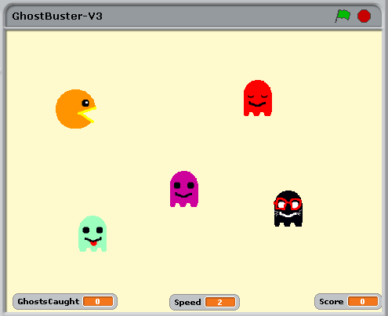
Today's Ninja Challenge: Make Better GhostBuster Game
Background!
Chomp!
Blink!
Tongue!
Music!

Slide 3
Today's Big Ideas
Communicating Sprites
Animation
Loops
Build on last week …

Slide 4
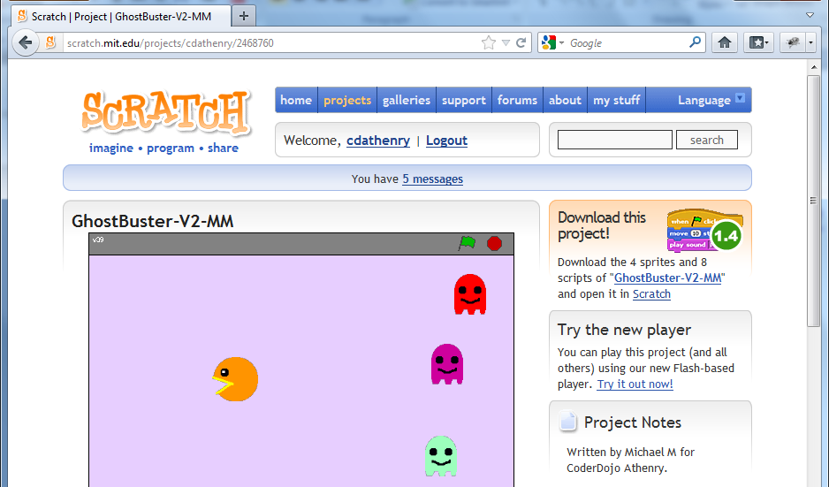
No Game from Last Week? No Problem!
Go to http://scratch.mit.edu/users/cdathenry
and download Ghostbuster-V2-MM

Slide 5
Steps To Make Your Improved Game
Add an eyes-shut costume for each ghost,
Code to make it animate between costumes
Make ghosts broadcast a message when they're eaten
Animate PacMan to chomp when it
receives a broadcast that a Ghost is eaten
Make PacMan broadcast each new level,
Make the stage change colour for them
Select a music track for the Stage, Add code to make it play forever

Slide 6

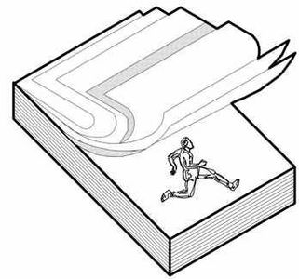
How Animation Works
Reminder from a recent week

Slide 7
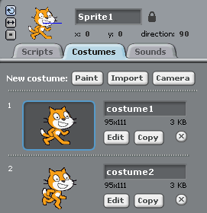


How Animation Works
Reminder from a recent week

Slide 8
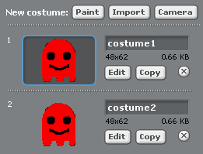
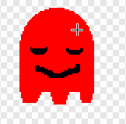
Animate Your Ghosts: Costume
Copy the original
Edit the copy
Make costume2 different

Slide 9
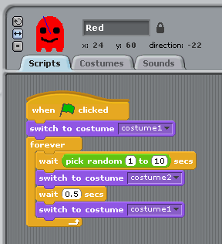
Animate Your Ghosts: Code
At the start, not blinking
Every now and again…
Close eyes for ½ second,
then open them again

Slide 10
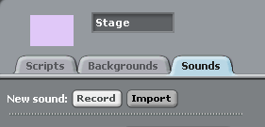
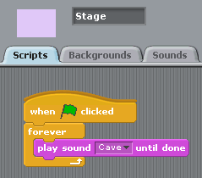
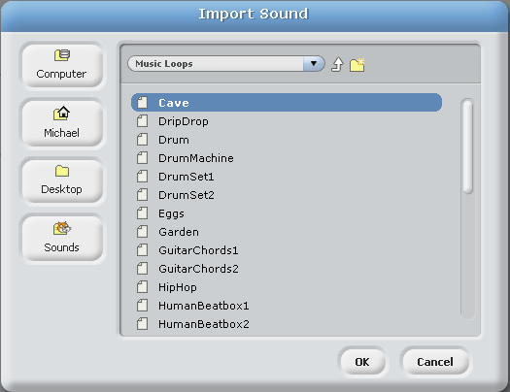
A Music Loop

Slide 11

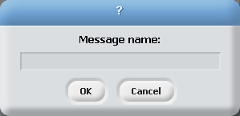






Broadcasts: How Sprites Communicate
1: Make new message
All computer languages have ways of exchanging data/messages between different parts of code
2: A sprite broadcasts it
3: Others can react to it

Slide 12
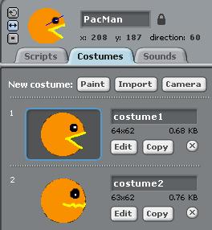



Making PacMan Chomp: Costumes
TIP: to make sure only difference is mouth,
re-draw with no mouth, copy, then
add different mouths in each costume.

Slide 13
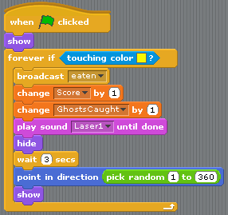
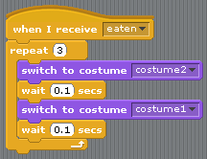
Making PacMan Chomp: Code
Make new message
All ghosts: Add 1 line
PacMan: Add block of code

Slide 14
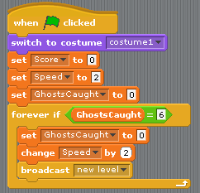
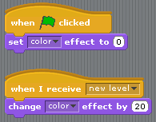
Change Background Colour at Each Level
PacMan: Add 1 line
Stage: Add 2 blocks of code

Slide 15
At the End …
Upload your project to the Scratch Website
user: emcdojo password: cork123
Access it from home
Improve it
Show your friends!

